Slide 1
Data Analyis project
Capstone Tableau
Presented By – Anshul Chauhan

Slide 2
Objective
Attrition Investigation:
Figure out how many people are leaving us in different groups. Understand why they might be choosing to go away.
What's Behind Attrition:
Explore the things that might be making people leave. Look into various factors that could be affecting why some customers decide to go.
Encouraging Customer Loyalty:
Learn about the reasons why customers decide to stick around. Understand what makes our existing customers happy and want to stay with us.

Slide 3
Data Driven questions
Display the percentage of the attrited and the existing customers from the data
Display gender-wise percentage of the attrited and the existing customers
Display region-wise percentage of the attrited and the existing customers.
Display the percentage of the attrited and the existing customers for each card category.
Display the percentage of the attrited and the existing customers for each income category
Display region-wise count of customers Identify the region that has the maximum number of customers
Create an interactive dashboard by following the given instructions.
Create a Figma template for the dashboard
Design the dashboard with the charts created in tasks 1-6
Apply action filters on the charts created in tasks 1 and 6

Slide 4
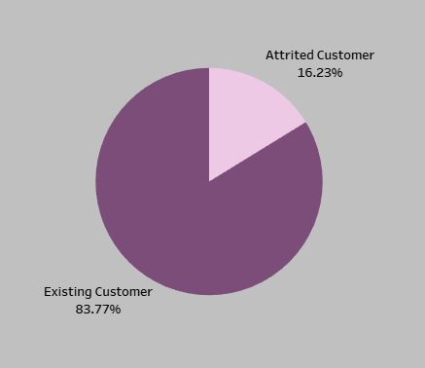
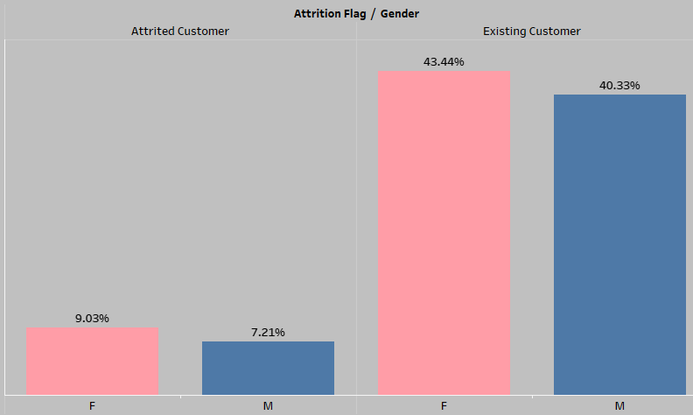
Task : Display the percentage of the attrited and the existing customers from the data
Task : Display the percentage of the attrited and the existing customers from the data
Interpretation :.This Pie chart shows that 16.23% are attrited customers and 83.77% are Existing Customers .
Interpretation : These bar charts shows gender wise Attrited and existing customers.

Slide 5
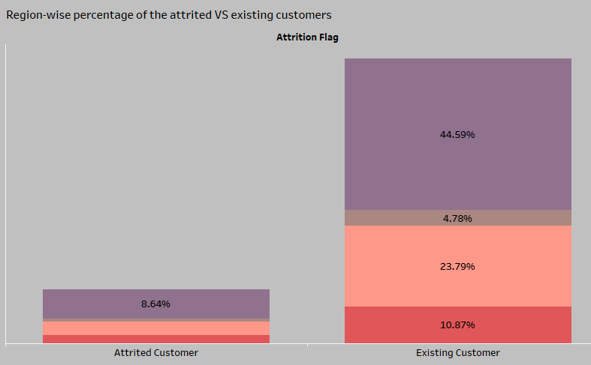
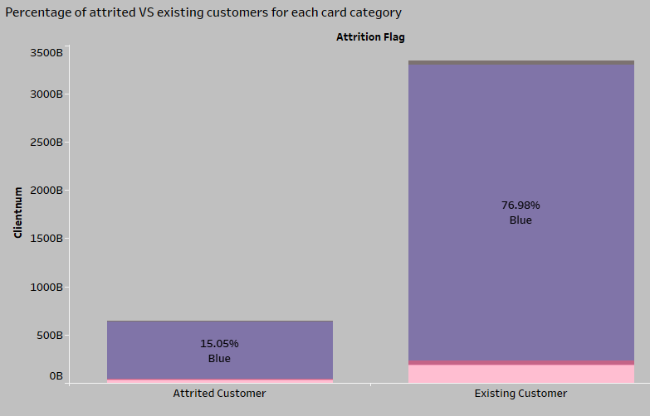
Task : region-wise percentage of the attrited and the existing customers.
Task : Display the percentage of the attrited and the existing customers for each card category
Interpretation :. A bar chart showing the region wise percentage of attrited versus existing customers with leading region is England
Interpretation : A bar chart showing the Card Category wise percentage of attrited versus existing customers with leading Card category is Blue

Slide 6
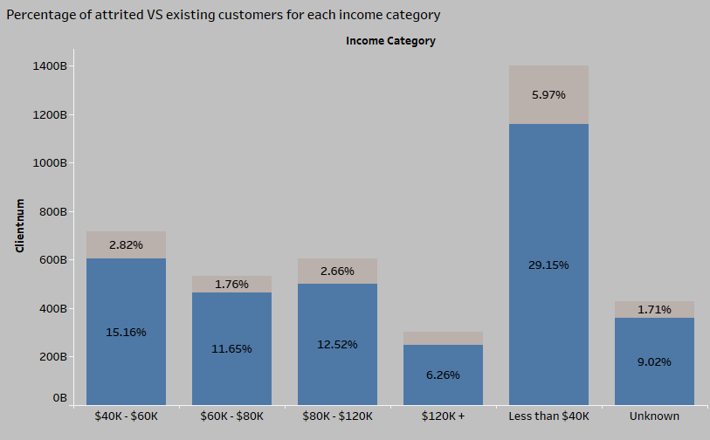
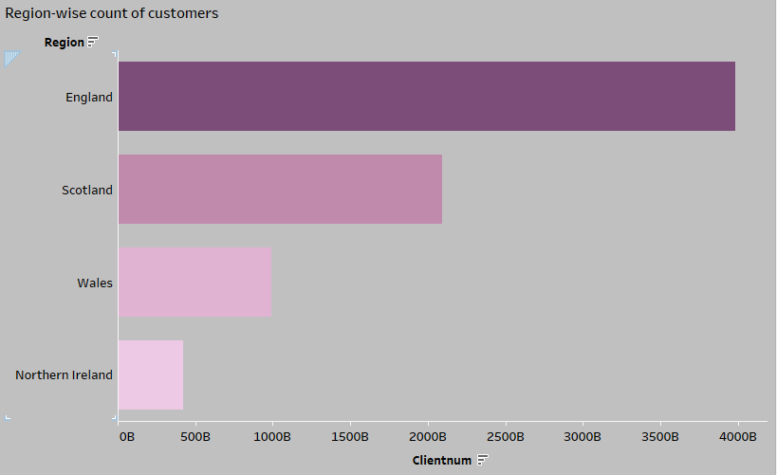
Task : Display the percentage of the attrited and the existing customers for each income category
Task :Display region-wise count of customers Identify the region that has the maximum number of customers
Interpretation : A stack bar chart showing the percentage of attrited versus existing customers by income category.
Interpretation : A horizontal bar chart showing the attrition count by region in descending order.

Slide 7
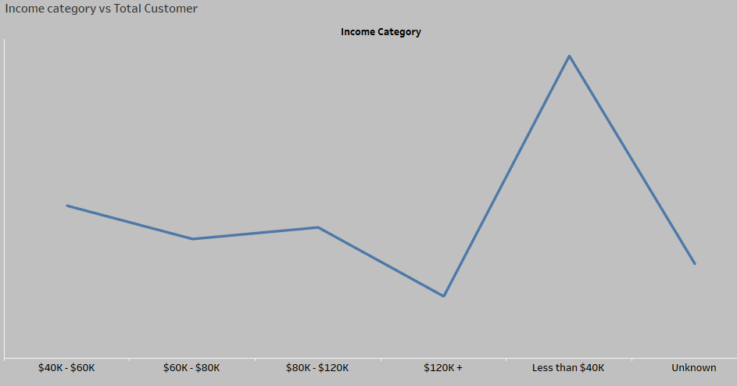
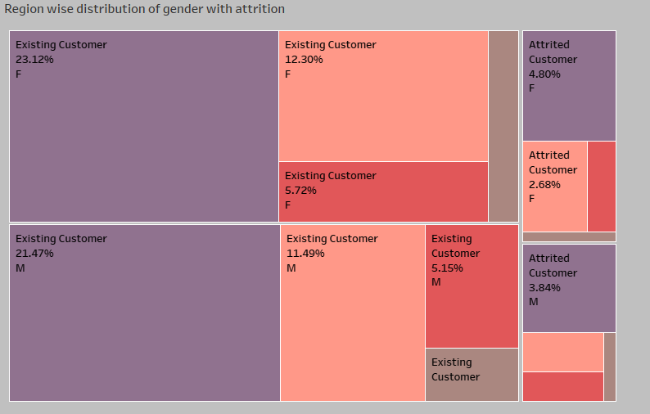
Task :Display Income category Wise Total Customer
Task :Display Region wise distribution of gender with attrition
Interpretation : THIS LINE CHART SHOWS THE TREND OF CUSTOMER BASED ON INCOME
Interpretation : This Tree map shows the relationship between existing and attrited customers wrt gender and region

Slide 8
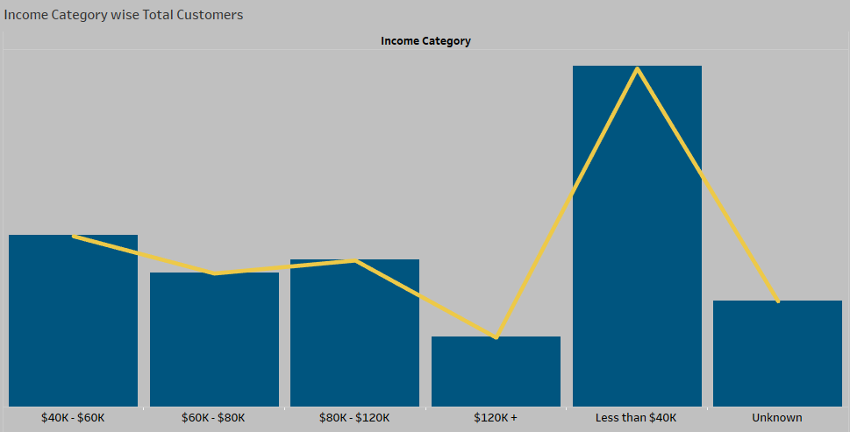
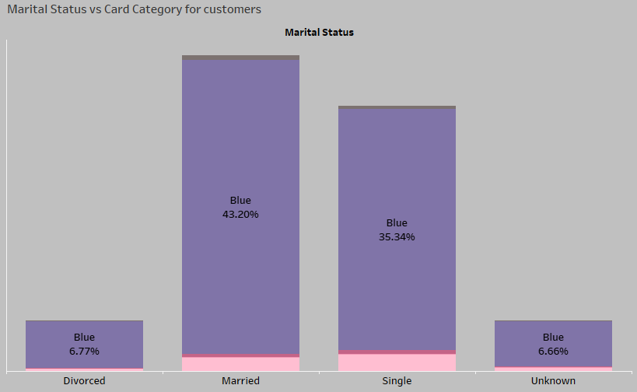
Task :Display Income Category wise Total Customers
Task :Display Marital Status vs Card Category for customers
Interpretation : A dual axis chart showing the revolving balance and transfer amount by income category.
Interpretation : This stacked bar chart shows the relationship between marital status with card categories with in total customers

Slide 9
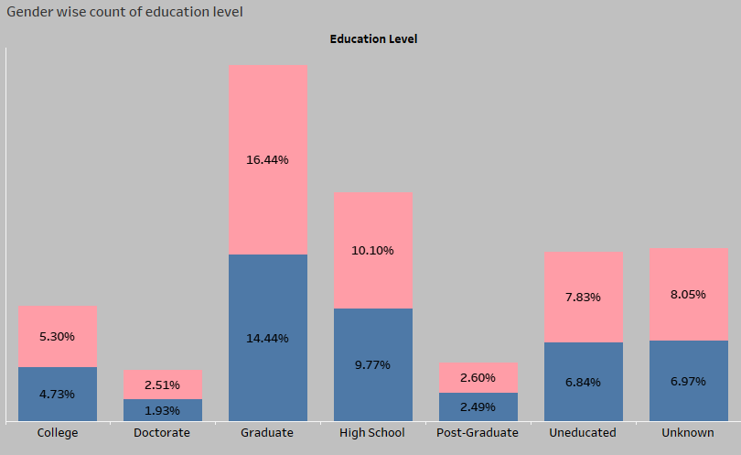
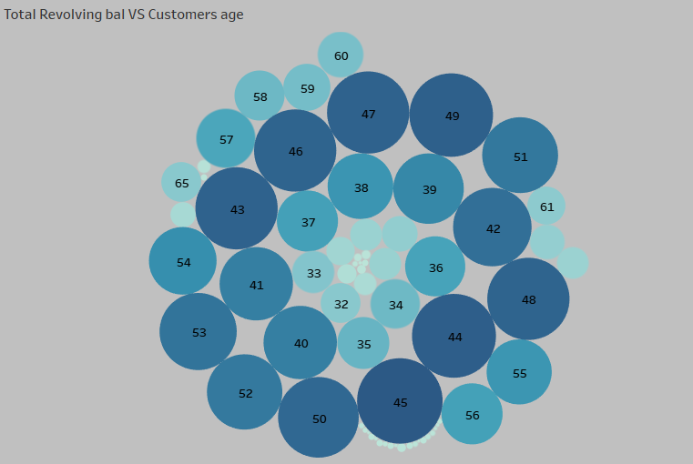
Task :Display Gender wise count of education level
Task :Display Total Revolving balance VS Customers age
Interpretation :This stacked bar chart display the gender wise count of education level .
Interpretation : This circle chart shows different ages with total revolving balance .

Slide 10
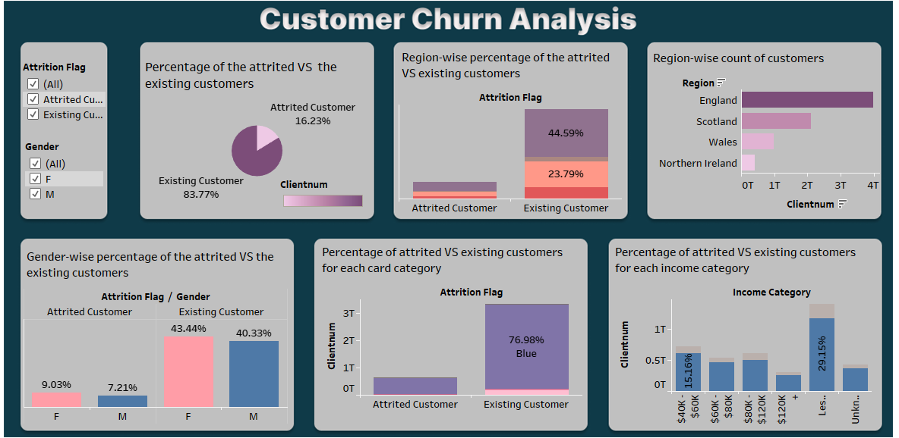
TASK – Show dashboard for percentage of attrited vs existing customers by different categories
Interpretation :our dynamic dashboard, showcasing the ratio of customers who have transitioned versus those who are still engaged, segmented across diverse categories. Uncover insights to refine strategies for customer retention.
Link :https://public.tableau.com/views/CapstoneProject1_17022110981530/Dashboard1?:language=en-US&:display_count=n&:origin=viz_share_link

Slide 11
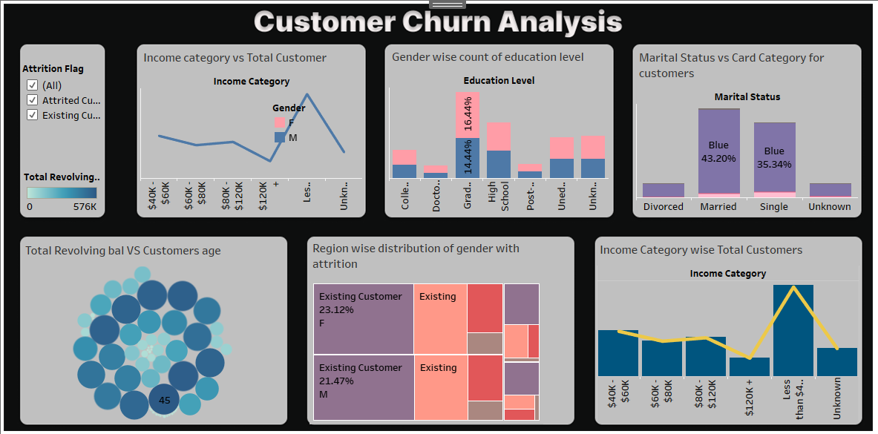
TASK – Show dashboard to visualize relation between different fields and measures.
Interpretation :A dashboard showing the relation between different measures.
Link :https://public.tableau.com/views/CapstoneProject_17021987403340/Dashboard1?:language=en-US&publish=yes&:display_count=n&:origin=viz_share_link

Slide 12
Conclusion
More Women Customers:
We have a higher percentage of female customers, and this holds true for both those who are still with us and those who have moved on.
England Takes the Lead:
Among our customers, England has the largest portion, meaning we have the most customers from England compared to other places.
Popular Blue Cards:
The most common type of card our customers have is the Blue card. It's the one that many of our customers prefer or have.
Earnings Below $40K:
The majority of our customers earn less than $40,000. So, most people who are our customers make less than this amount of money.

Slide 13
Thankyou

